Slide 1

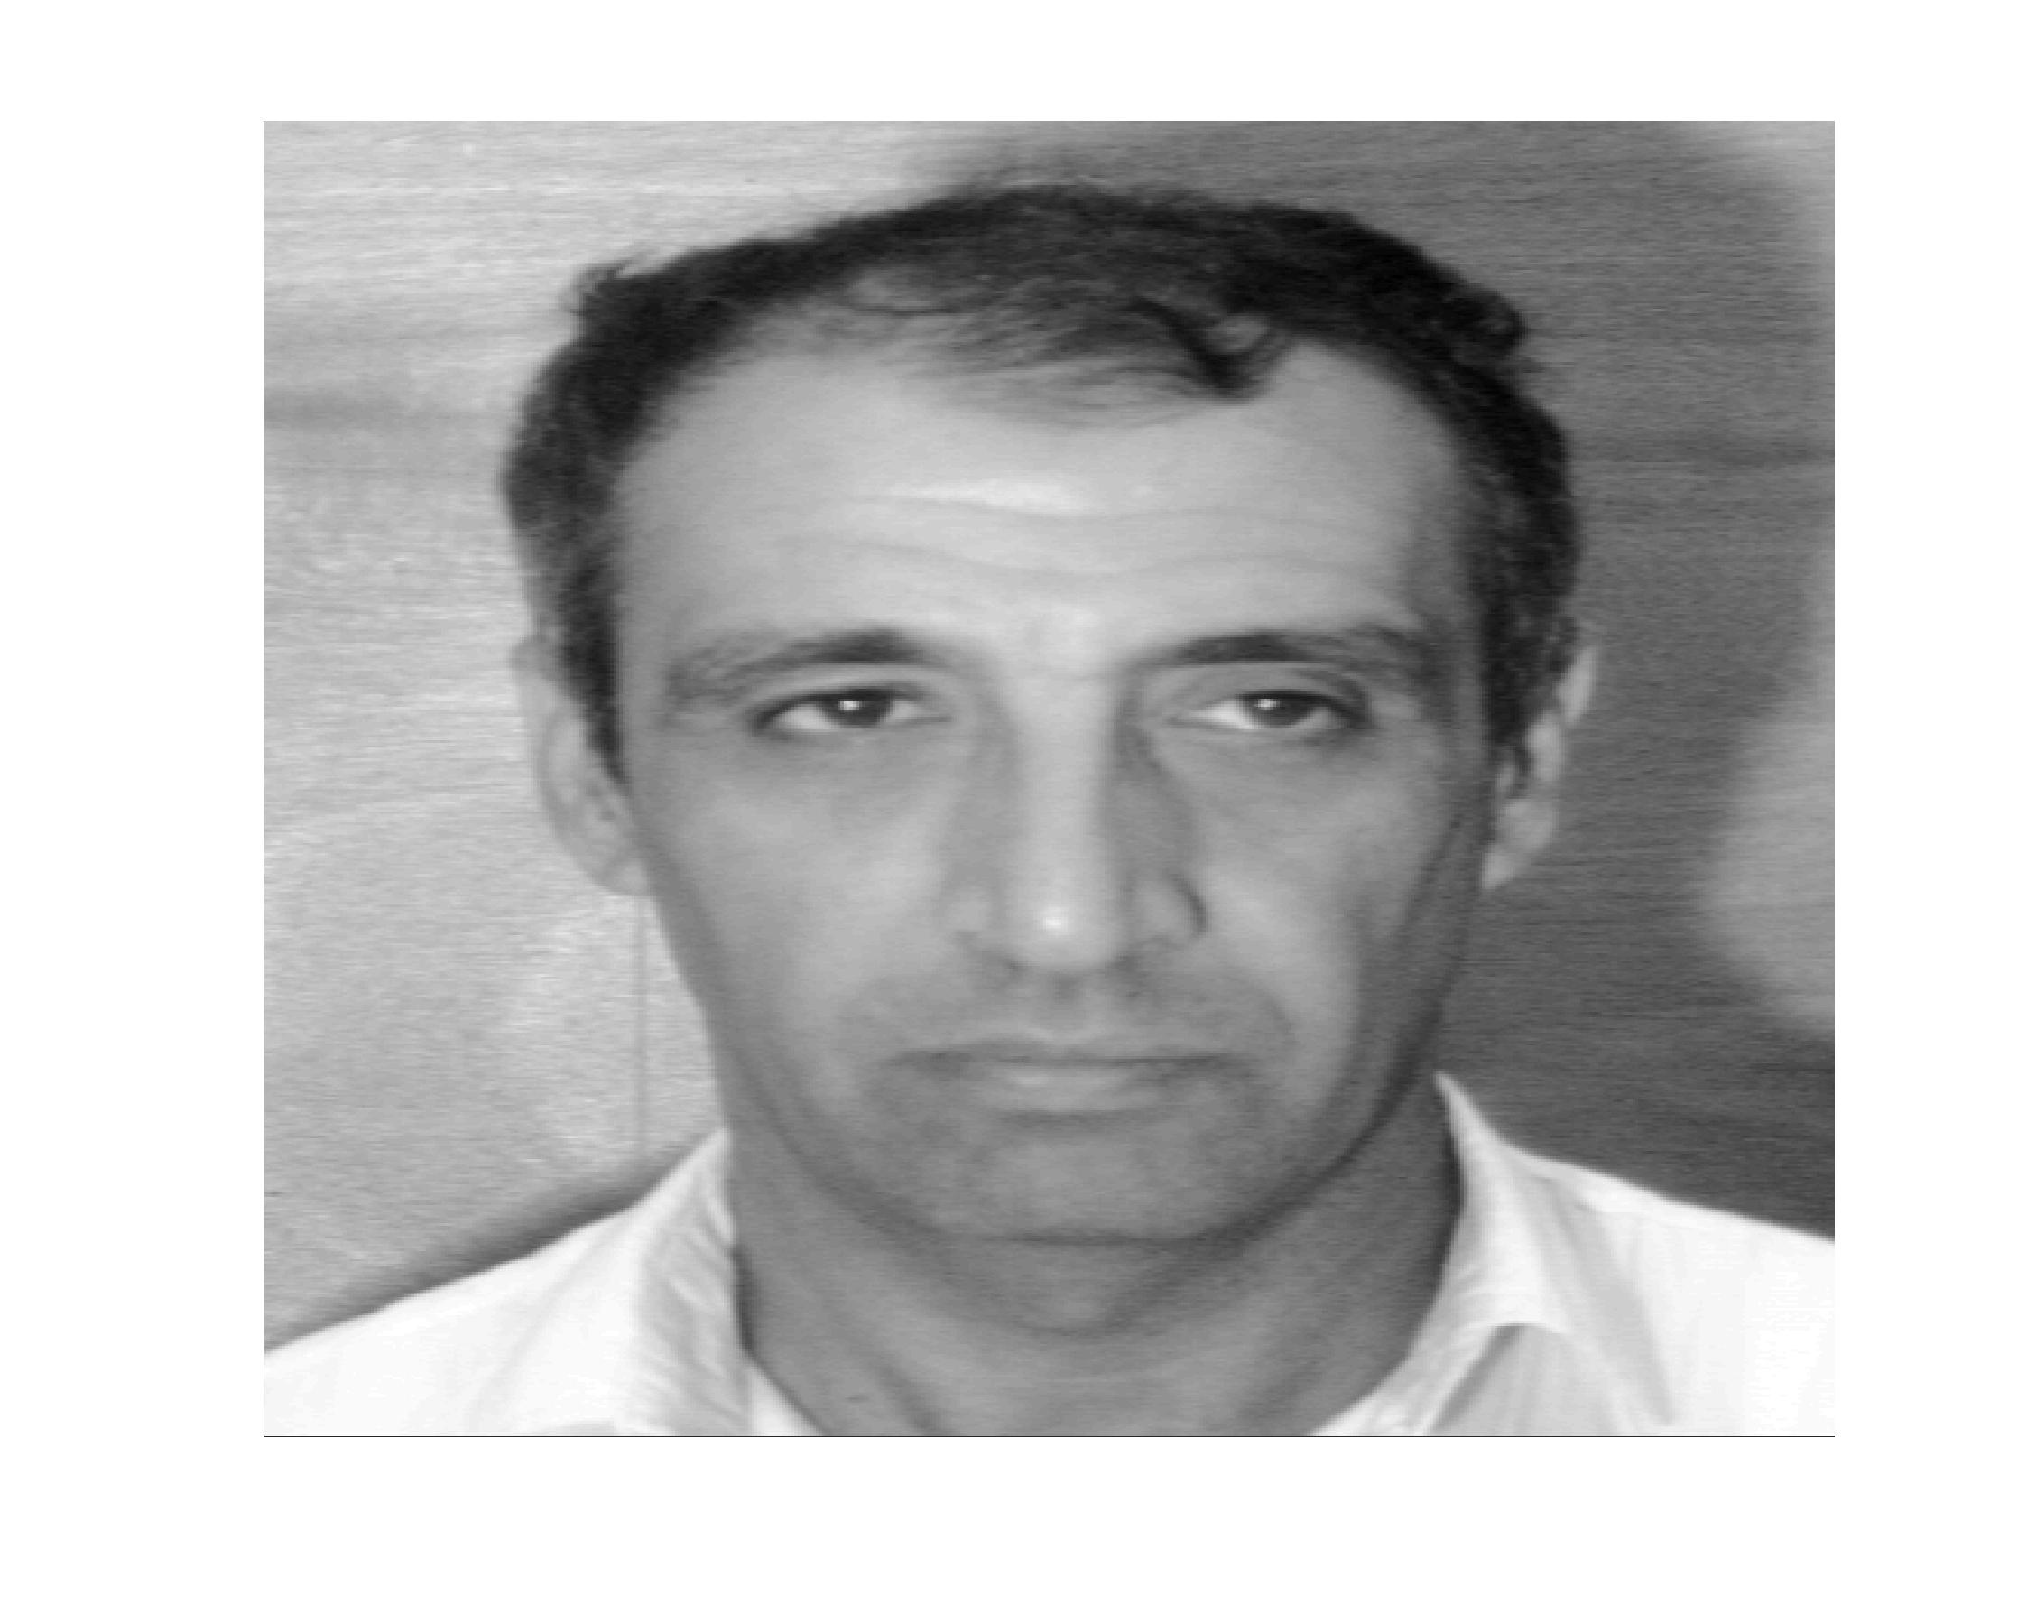
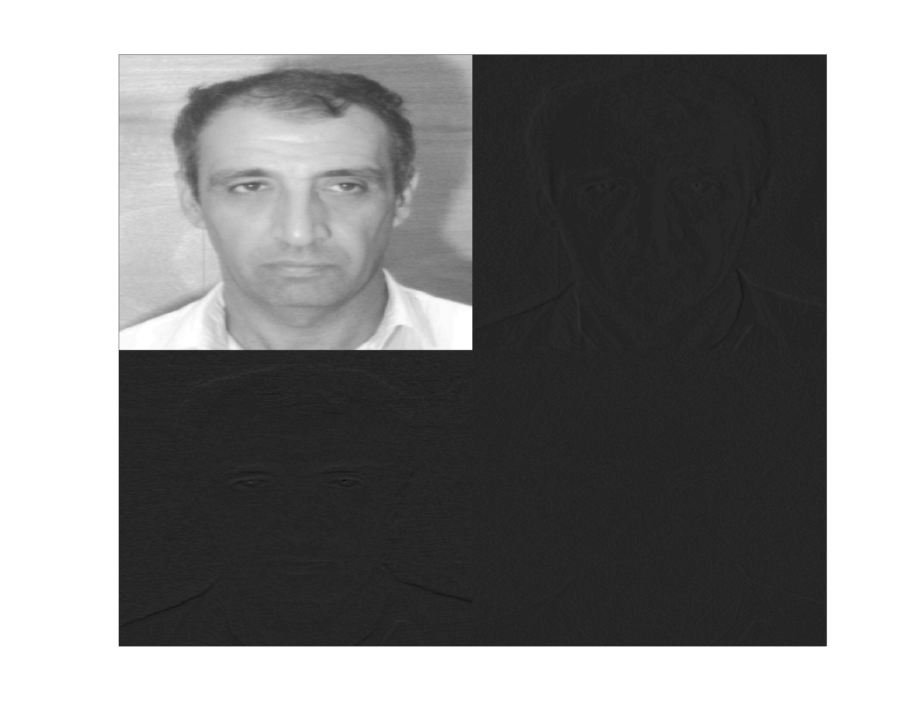
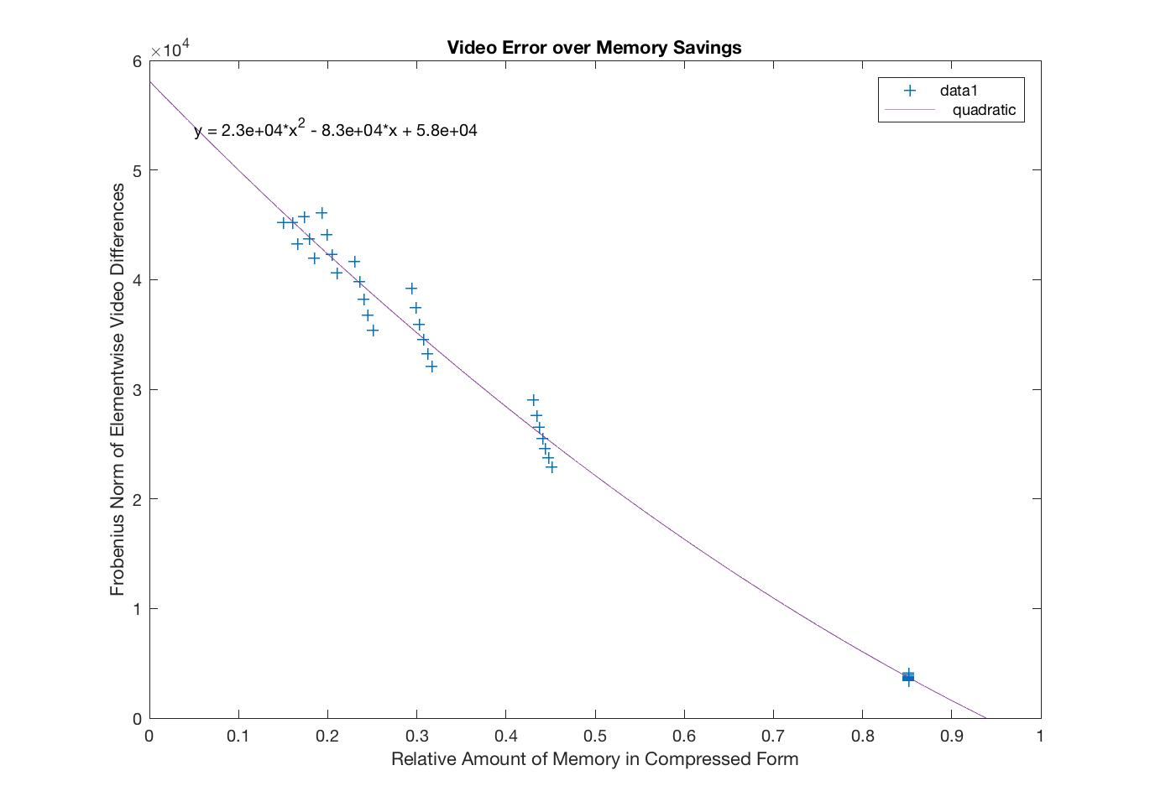
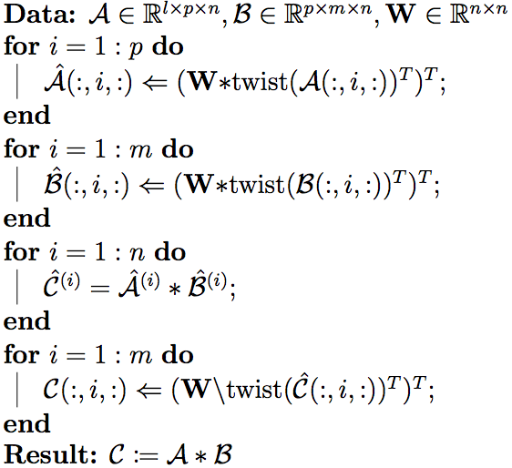
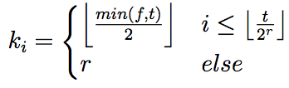
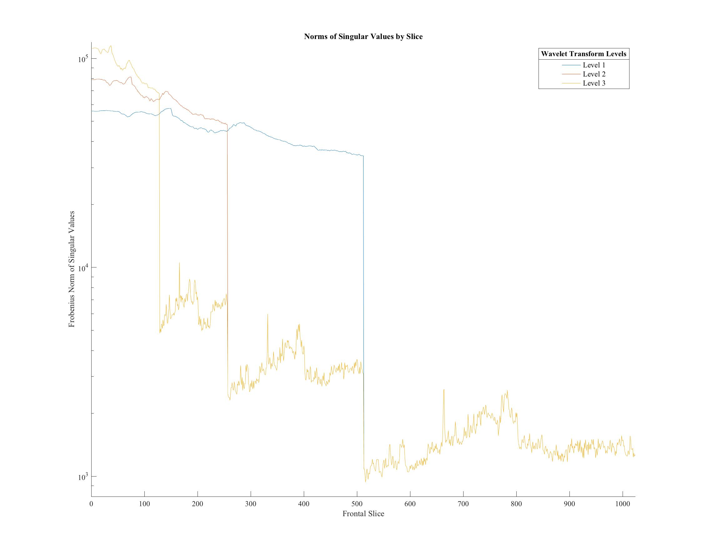
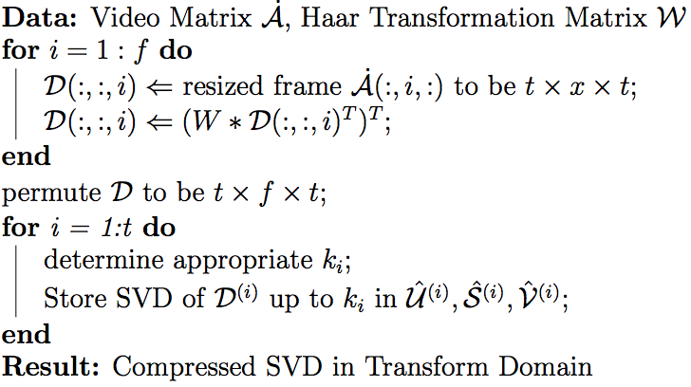
Zoom Video Compression Using a Compressed Tensor Singular Value Decomposition
Michael Thramann, Advisor: Misha Kilmer
Tufts University, Department of Mathematics
Introduction:
The increasing ubiquity of video applications has placed new demands on data storage and processing. Tensors, and their factorizations, have appropriately become increasingly common in video and image processes. My research demonstrates the utility of a multilinear tensor approach to compressing zooming video. Previous uses of the tensor singular value decomposition (tSVD) have focused on visual classification and recognition problems. I took advantage of the generalities in tensor operations and an abstraction of the truncated singular value decomposition to decrease memory demands significantly while experiencing minor picture quality loss.
Algorithms:
Note: The twist() function permutes the 2nd and 3rd tensor dimensions.
T-Product under transformation matrix W:
Haar Video Compression:
Haar Discrete Wavelet Transform:
This simple wavelet basis works recursively on powers of 2, and is often used as a pre-condition for image compression. Below is an example of an image passed through one iteration of a discrete wavelet transform.
Truncation Strategies:
Unlike the second-order tensor case (a matrix), higher-order tensors often lack rank-optimal approximations, as even the characterization of “rank” is tenuous. Furthermore, I limited my possible truncation schemes to those which have pre-determined truncation indices so that the Lanczos iterations could halt prematurely and save computation time.
I ultimately used the following equation to calculate truncation indices for each slice i, video dimension t, frames f, and transform iterations r.
This follows from the sets of truncation values, based on the transform iterations:
Results:
See original and compressed videos.
Below is a plot of quantitative video error (third-order Frobenius norm of difference), compared to the relative amount of memory required in compressed form.
Further Work:
An optimal automated scheme to choose truncation values has yet to be developed. It also might be beneficial to consider other linear transforms and their applications to various video characteristics. I would also consider non-visual data that might have redundancies over a time-dimension to be well-suited for this kind of machinery.
Acknowledgements:
The author would like to thank Misha Kilmer for funding and guidance into the area of Numerical Linear Algebra and tensor applications. The author is also indebted to Professor Shuchin Aeron (Tufts Electrical and Computer Engineering) for some of the MATLAB programs used in this research.
References:
[1] Jie Chen and Yousef Saad. On the tensor svd and the optimal low rank orthogonal approximation of tensors. SIAM J. Matrix Anal. Appl., 30(4):1709–1734, January 2009.
[2] Ning Hao, Misha E. Kilmer, Karen Braman, and Randy C. Hoover. Facial Recognition Using Tensor- Tensor Decompositions. SIAM J. Imaging Sciences, 6:437–438, 2013.
[3] Eric Kernfeld, Misha Kilmer, and Shuchin Aeron. Tensor-tensor products with invertible linear trans- forms. Linear Algebra and its Applications, 485:545 – 570, 2015.
[4] Tamara G. Kolda and Brett W. Bader. Tensor decompositions and applications. SIAM Review, 51(3):455– 500, 2009.
Notes:
Single sided poster!

Slide 2
Zoom Video Compression Using a Compressed Tensor Singular Value Decomposition
Michael Thramann, Advisor: Misha Kilmer
Tufts University, Department of Mathematics
Notes:
Single sided poster!

Slide 3
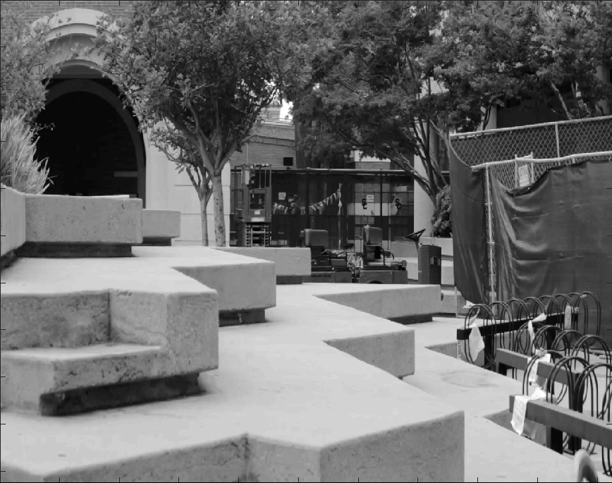
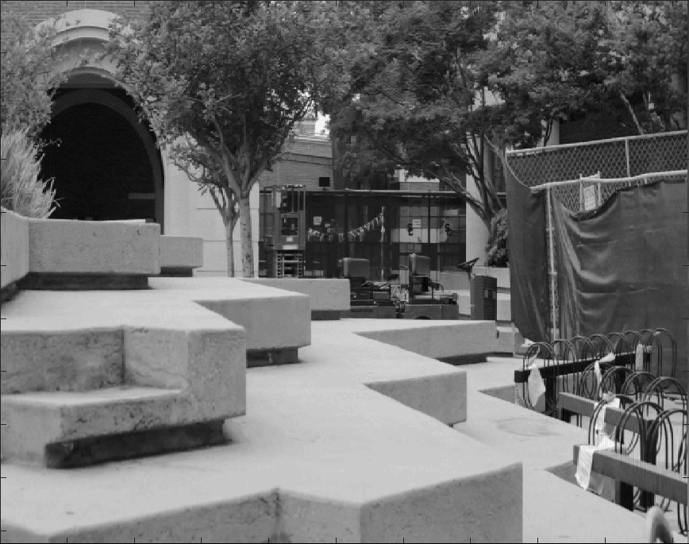


Zoom Video Compression Using a Compressed Tensor Singular Value Decomposition
Michael Thramann, Advisor: Misha Kilmer
Tufts University, Department of Mathematics
Top Left: Original Video
Top Right: 49.37% savings
Bottom Left: 73.56% savings
Bottom Right: 90.29% savings
Notes:
Single sided poster!

Slide 4
Zoom Video Compression Using a Compressed Tensor Singular Value Decomposition
Michael Thramann, Advisor: Misha Kilmer
Tufts University, Department of Mathematics
Notes:
Single sided poster!

Slide 5
Zoom Video Compression Using a Compressed Tensor Singular Value Decomposition
Michael Thramann, Advisor: Misha Kilmer
Tufts University, Department of Mathematics
Notes:
Single sided poster!

